Slide 1

Department of Computer Science and Engineering
ANALYSIS AND PREDICTION OF COVID-19 USING TIME SERIES FORECASTING
Date: 19 April 2021
Padmasree Alagam : 17wh1a05a3
Talluri Kavya : 17wh1a0571
Santhoshi Kukkadapu : 17wh1a0587
Internal Guide : Dr. K. Srinivasa Reddy
Designation : Head of the Department,CSE

Slide 2

Abstract
Why Should I Study this course?
This project focuses on the data analytics for the available data for COVID-19 pandemic disease. In this project, python and its libraries are applied for the exploratory data analysis of the dataset. Considering the variation of the scenario with time, it has been observed to analyze the data with the time series analysis in order to forecast the future effect of corona virus globally. This analysis has been conducted using six methods,viz. AR, MA, SVM, FB Prophet, Holt's linear trend method, Holt's Winter seasonal method and ARIMA model. Worldwide vaccination is also analyzed in this project for future forecasting of vaccination percentages of different countries.
Examples
BVRIT HYDERABAD College of Engineering for Women

Slide 3
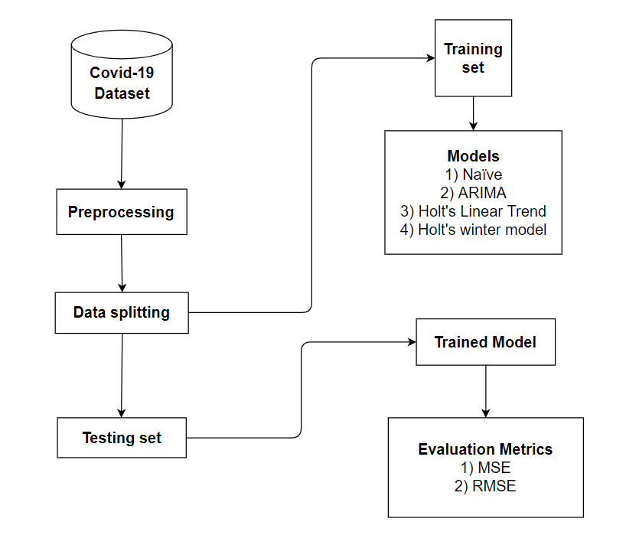
Design Model
Why Should I Study this course?
Examples
BVRIT HYDERABAD College of Engineering for Women

Slide 4
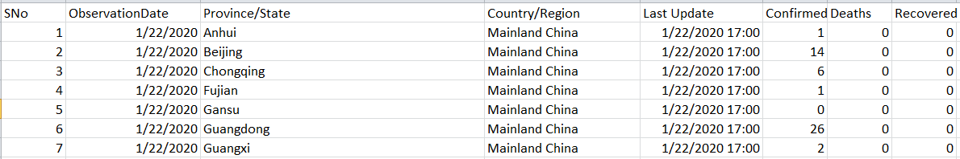
Dataset
Why Should I Study this course?
Examples
R. K. Sudalai, "Novel Corona Virus 2019 Dataset day level information on covid-19 affected cases", Kaggle, June 2020.
BVRIT HYDERABAD College of Engineering for Women

Slide 5
Technology Stack
Why Should I Study this course?
Language
Python
Data Visualization Libraries
matplotlib
seaborn
Data Analytics Libraries
pandas
numpy
sklearn
Examples
BVRIT HYDERABAD College of Engineering for Women

Slide 6
References
Why Should I Study this course?
[1]. S. Maurya and S. Singh, "Time Series Analysis of the Covid-19 Datasets," 2020 IEEE International Conference for Innovation in Technology (INOCON), Bangluru, India, 2020
[2]. S. Shaikh, J. Gala, A. Jain, S. Advani, S. Jaidhara and M. Roja Edinburgh, "Analysis and Prediction of COVID-19 using Regression Models and Time Series Forecasting," 2021 11th International Conference on Cloud Computing, Data Science & Engineering (Confluence), Noida, India, 2021
[3] O. Sarkar, M. F. Ahamed and P. Chowdhury, "Forecasting & Severity Analysis of COVID-19 Using Machine Learning Approach with Advanced Data Visualization," 2020 23rd International Conference on Computer and Information Technology (ICCIT), DHAKA, Bangladesh, 2020
[4]. G. R. Shinde, A.B. Kalamkar, P.N. Mahalle, N. Dey, J. Chaki and A.E. Hassanien, "Forecasting Models for Coronavirus Disease (COVID-19): A Survey of the State-of-the-Art", SN Computer Science, vol. 1, no. 4, pp. 1-15, 2020.
Examples
BVRIT HYDERABAD College of Engineering for Women

Slide 7
THANK YOU

